Slide 1

User-Defined Functions in Ansys Fluent
Ayaaz Yasin
EGFD 5137C/6037C Computational Fluid Dynamics April 13, 2026

Slide 2
Motivation
CFD simulations often require customization of the solution method, governing equations, data management, etc. User-Defined Functions (UDFs) allow custom code to be implemented in Ansys Fluent.
Common Uses:
Custom Boundary Conditions
Custom Material Properties
Custom Source Terms
Custom Reaction Rates and Chemistry
Custom Turbulence Modeling
Dynamic Mesh and Moving Boundaries
Custom Initialization
Post-Processing and Solution Monitors
Particle Models and Drag Laws
Radiation and Heat Transfer
Electrochemical and Multiphysics Applications
Customizing Solver Behavior

Slide 3
Common UDFs (1)
Category | UDF Macro | Use Case
Boundary Conditions | DEFINE_PROFILE | Define non-uniform boundary conditions (velocity, temperature, pressure, species) at inlets, outlets, or walls
 | DEFINE_INLET_TURBULENCE | Specify custom turbulence quantities (k, ε, ω) at inlets
Material Properties | DEFINE_PROPERTY | Define custom material properties (viscosity, density, thermal conductivity, Cp) as functions of temperature, pressure, or composition
 | DEFINE_DIFFUSIVITY | Define species or energy diffusivity
Source Terms | DEFINE_SOURCE | Add custom source/sink terms to any transport equation (momentum, energy, species, turbulence)
 | DEFINE_HEAT_FLUX | Define custom heat flux at wall boundaries
Reaction & Chemistry | DEFINE_VR_RATE | Define custom volumetric reaction rates for species transport
 | DEFINE_SR_RATE | Define custom surface reaction rates at walls
 | DEFINE_HET_RXN_RATE | Define heterogeneous reaction rates (solid-gas reactions)
Dynamic Mesh | DEFINE_GEOM | Define geometry of a deforming or moving boundary
 | DEFINE_GRID_MOTION | Prescribe rigid body or arbitrary motion of mesh zones
 | DEFINE_CG_MOTION | Define center-of-gravity motion for 6-DOF moving bodies
 | DEFINE_SDOF_PROPERTIES | Define mass, moment of inertia, and forces for 6-DOF solver

Slide 4
Common UDFs (2)
Category | UDF Macro | Use Case
Discrete Phase (DPM) | DEFINE_DPM_DRAG | Define custom drag coefficient for non-spherical particles
 | DEFINE_DPM_SOURCE | Define custom source terms from particles to continuous phase
 | DEFINE_DPM_BC | Define custom particle-wall interaction (reflection, absorption, etc.)
 | DEFINE_DPM_INJECTION_INIT | Initialize particle properties at injection
 | DEFINE_DPM_LAW | Define custom particle heat/mass transfer laws
Turbulence | DEFINE_TURBULENT_VISCOSITY | Define custom turbulent viscosity for modified turbulence models
 | DEFINE_WALL_FUNCTIONS | Define custom near-wall treatment
User-Defined Scalar (UDS) | DEFINE_UDS_FLUX | Define convective flux for a user-defined scalar transport equation
 | DEFINE_UDS_UNSTEADY | Define transient term for a UDS equation
Initialization & Execution | DEFINE_INIT | Define custom field initialization at the start of simulation
 | DEFINE_EXECUTE_AT_END | Execute custom code at the end of each iteration or time step
 | DEFINE_EXECUTE_ON_LOADING | Execute code when the UDF is loaded into Fluent
 | DEFINE_ON_DEMAND | Execute a UDF manually on demand from the Fluent GUI
 | DEFINE_RW_FILE | Read/write custom data to case or data files
Multiphase | DEFINE_CAVITATION_RATE | Define custom cavitation source terms
 | DEFINE_EXCHANGE_PROPERTY | Define interphase exchange coefficients (drag, heat, mass transfer)
 | DEFINE_MASS_TRANSFER | Define custom mass transfer rates between phases

Slide 5
What is a function?
UDF Code
Input information from the Solver
Outputs returned
to the Solver

Slide 6
Common Cell Macros
Category | Macro | Description
Velocity | C_U(c,t) | Cell x-velocity component
 | C_V(c,t) | Cell y-velocity component
 | C_W(c,t) | Cell z-velocity component
Pressure & Density | C_P(c,t) | Cell static pressure
 | C_RHO(c,t) | Cell density
 | C_R(c,t) | Cell density (compressible flows)
Temperature | C_T(c,t) | Cell temperature
 | C_WALL_TEMP(c,t) | Wall temperature
Turbulence | C_K(c,t) | Cell turbulent kinetic energy (k)
 | C_D(c,t) | Cell turbulent dissipation rate (ε)
 | C_O(c,t) | Cell specific dissipation rate (ω)
 | C_MU_T(c,t) | Cell turbulent viscosity
 | C_MU_EFF(c,t) | Cell effective viscosity
 | C_NUT(c,t) | Cell Spalart-Allmaras turbulent viscosity
Energy | C_ENTHALPY(c,t) | Cell enthalpy
 | C_FMEAN(c,t) | Cell mean mixture fraction
 | C_FVAR(c,t) | Cell mixture fraction variance

Slide 7
Common Cell Macros (2)
Category | Macro | Description
Species | C_YI(c,t,i) | Cell mass fraction of species i
 | C_MOLEF(c,t,i) | Cell mole fraction of species i
Material Properties | C_LAMINAR_FLAME_SPEED(c,t) | Cell laminar flame speed
 | C_GRAVITY(c,t) | Gravitational acceleration at cell
 | C_CP(c,t) | Cell specific heat capacity
 | C_RGAS(c,t) | Cell gas constant
Geometry | C_VOLUME(c,t) | Cell volume
 | C_CENTROID(x,c,t) | Cell centroid coordinates (returns array x[])
 | C_NNODES(c,t) | Number of nodes in a cell
 | C_NFACES(c,t) | Number of faces in a cell
Gradients | C_U_G(c,t) | Gradient of x-velocity
 | C_V_G(c,t) | Gradient of y-velocity
 | C_W_G(c,t) | Gradient of z-velocity
 | C_T_G(c,t) | Gradient of temperature
 | C_P_G(c,t) | Gradient of pressure
Multiphase | C_VOF(c,t,phase) | Cell volume fraction of a phase
 | C_PHASE_DIAMETER(c,t) | Cell phase diameter (dispersed phase)

Slide 8
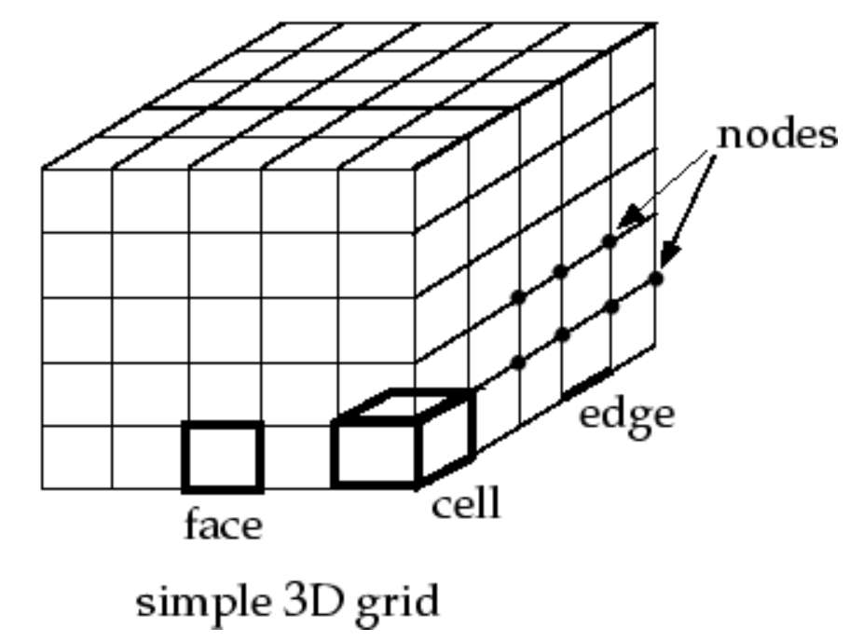
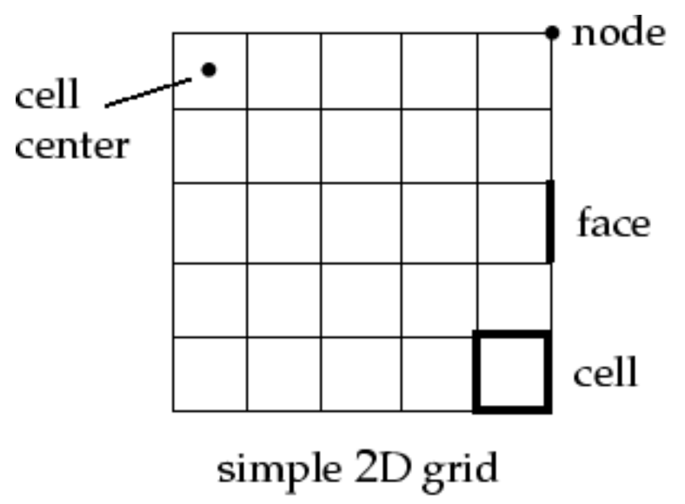
Mesh Terminology

Slide 9
Basic UDF Syntax
#include “udf.h”
Define_UDFtype(UDFname, arg1, arg2)
{
real var1;
var1 = 10*arg1 + arg2;
return var1;
}
Declare variables
Calculations
Return value to the solver

Slide 10

Access to activity files
github.com/ayaazyasin/UDF_demo

Slide 11
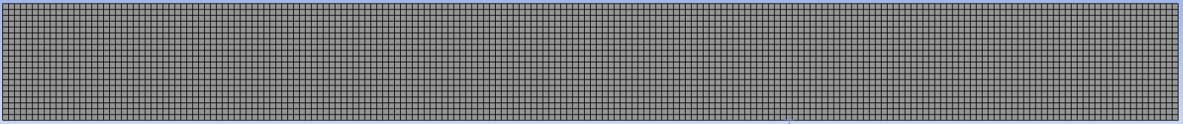

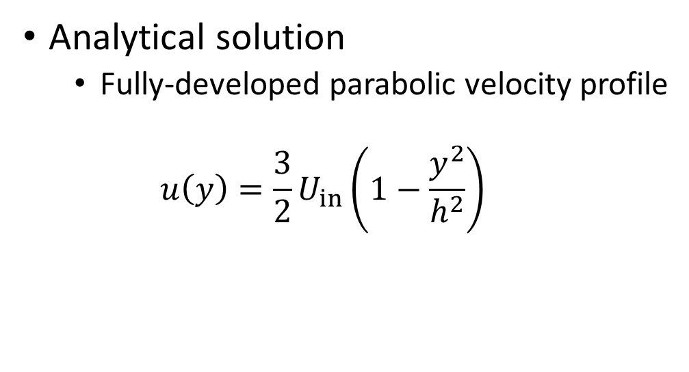
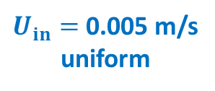

Activity 0 – Channel Flow
$L=$10 m
$h=$0.05 m
$U_{in}=$0.005 m/s
uniform
zero pressure
CFD setup
Incompressible flow
Water from Fluent library
200x20 quad mesh cells
Solver: Laminar SIMPLE
Convergence 1e-4
Analytical solution
Fully-developed parabolic velocity profile
$$u\left(y\right)=\frac{3}{2}U_{in}\left(1−\frac{y^{2}}{h^{2}}\right)$$

Slide 12
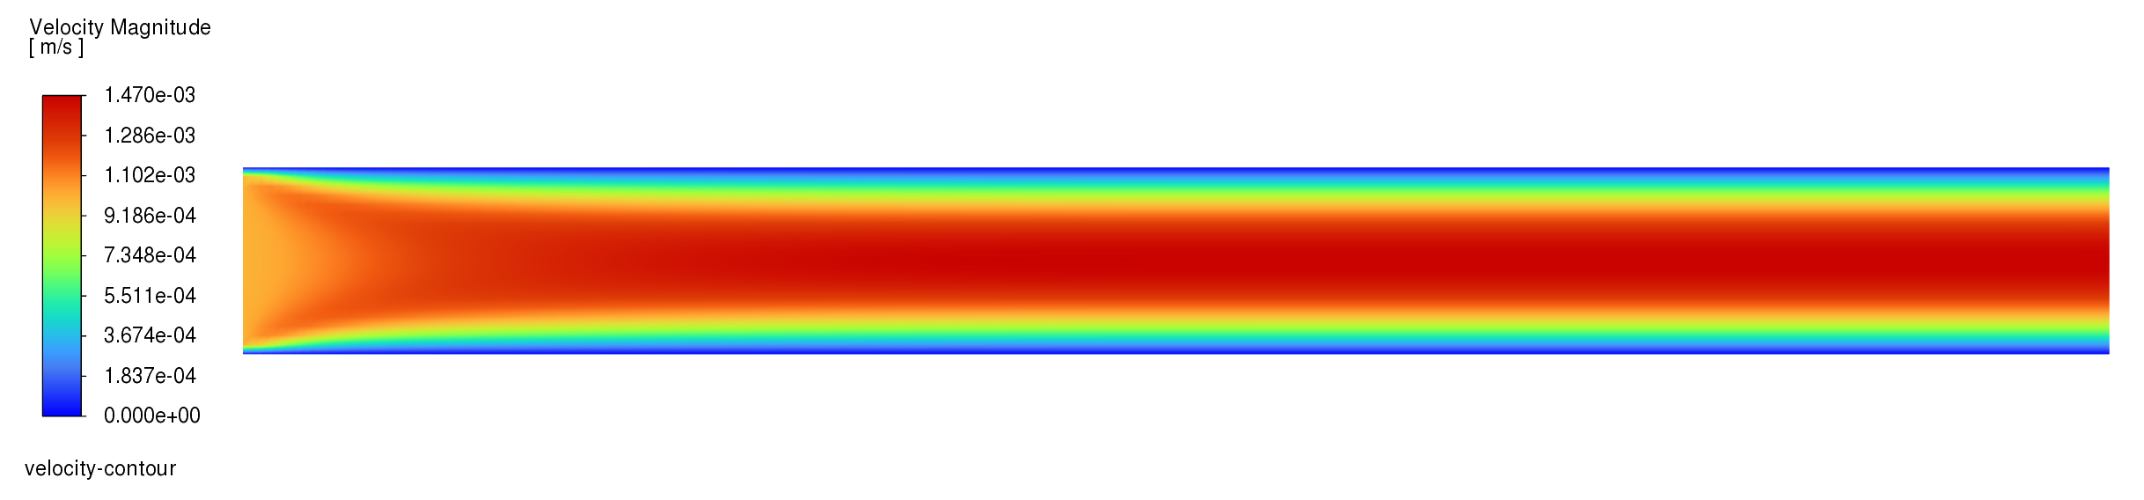
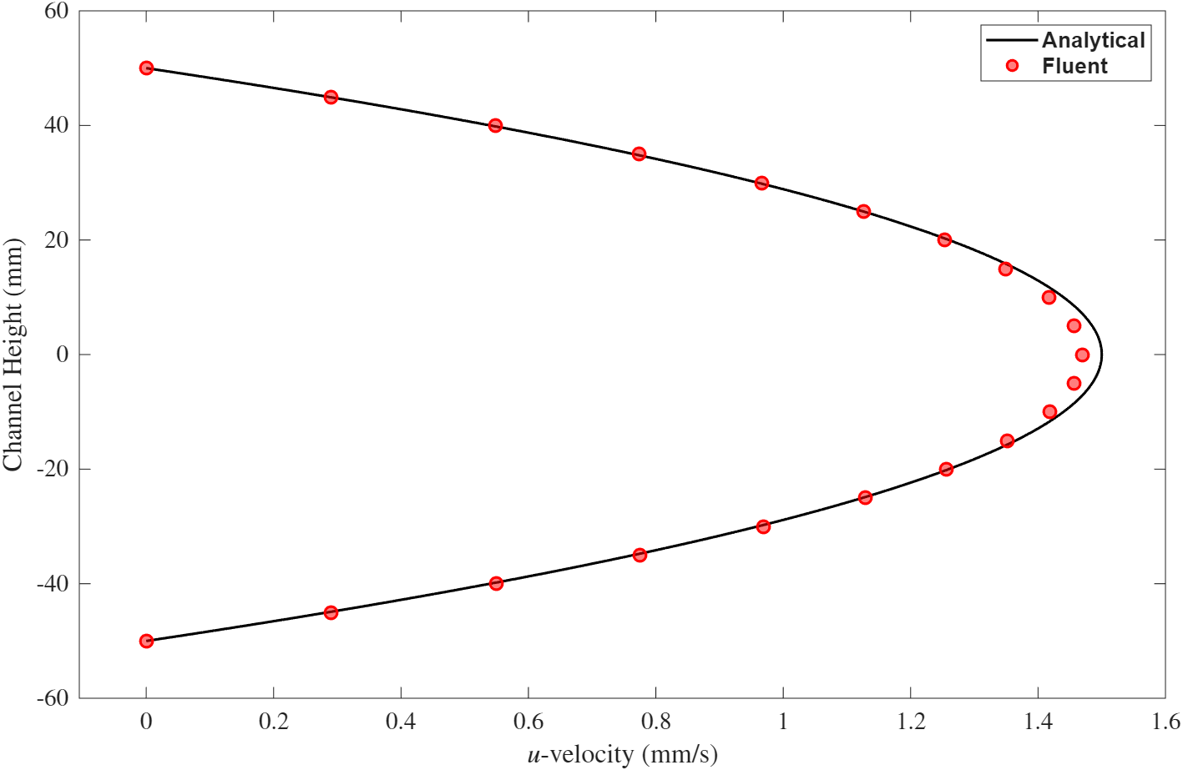
Activity 0 – Channel Flow (results)

Slide 13
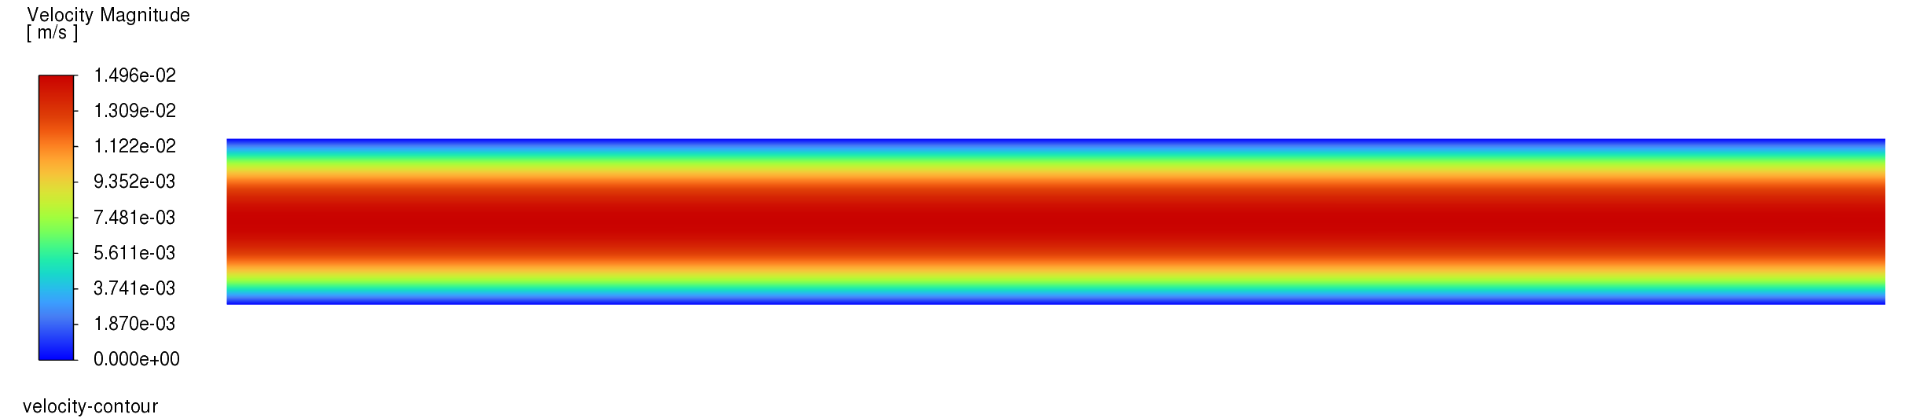
Activity 1 – Define Fully-Developed Inlet
Use inletProfile.c to define the inlet velocity.
Move file to \UDF_demo\UDF_demo_files\dp0\FLU\Fluent\libudf
Compile UDF in Fluent, check built-in compiler.
Attach to inlet boundary condition.

Slide 14
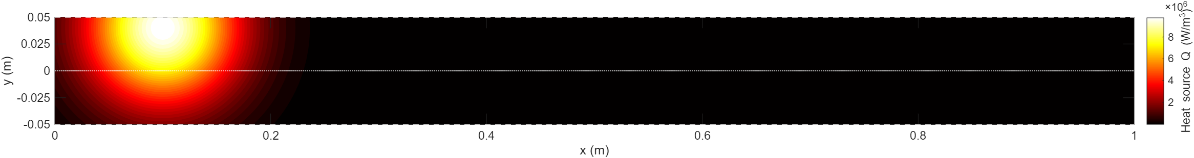
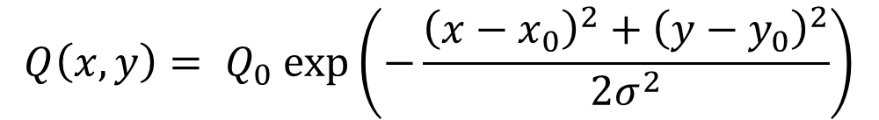




Activity 2 – Simulated laser heating
Use heatSource.c to define the inlet velocity.
Move file to \UDF_demo\UDF_demo_files\dp0\FLU\Fluent\libudf
Compile UDF in Fluent, check built-in compiler.
Attach to fluid domain.
The laser heating is simulated as a 2D Gaussian:
$$σ=0.05$$
$$x_{0}=0.1$$
$$Q\left(x,y\right)= Q_{0} exp\left(−\frac{{\left(x−x_{0}\right)}^{2}+{\left(y−y_{0}\right)}^{2}}{2σ^{2}}\right)$$
$$y_{0}=0.04$$
$$Q_{0}={10}^{7}$$

Slide 15
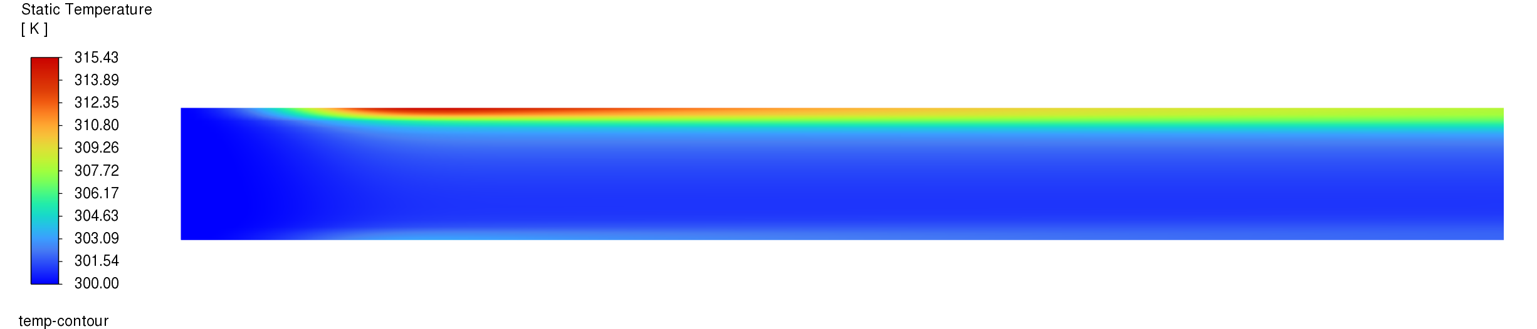
Activity 2 – Simulated laser heating (results)

Slide 16
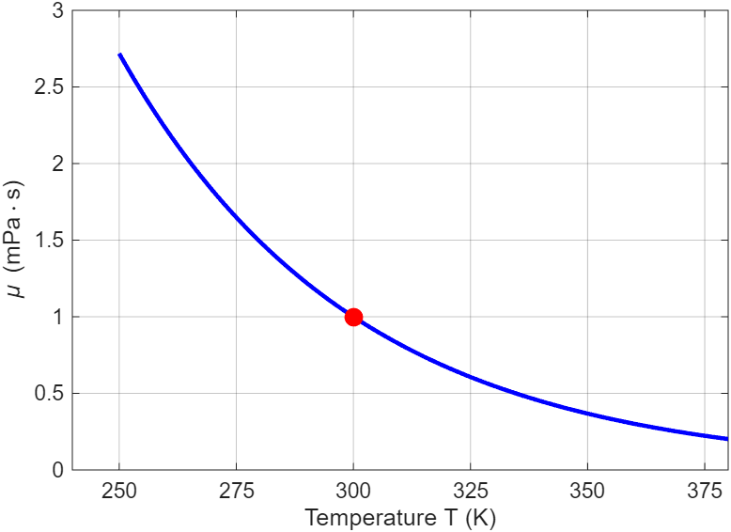



Activity 3 – Temperature-dependent viscosity
Use viscosityTemp.c to define the inlet velocity.
Move file to \UDF_demo\UDF_demo_files\dp0\FLU\Fluent\libudf
Compile UDF in Fluent, check built-in compiler.
Attach to material property.
Viscosity is simulated as a function of temperature.
$$μ\left(T\right)= μ_{ref}⋅\exp\left(−β\left(T − T_{ref}\right)\right)$$
$$μ_{ref}=0.001$$
$$T_{ref}=300$$
$$β=0.02$$

Slide 17
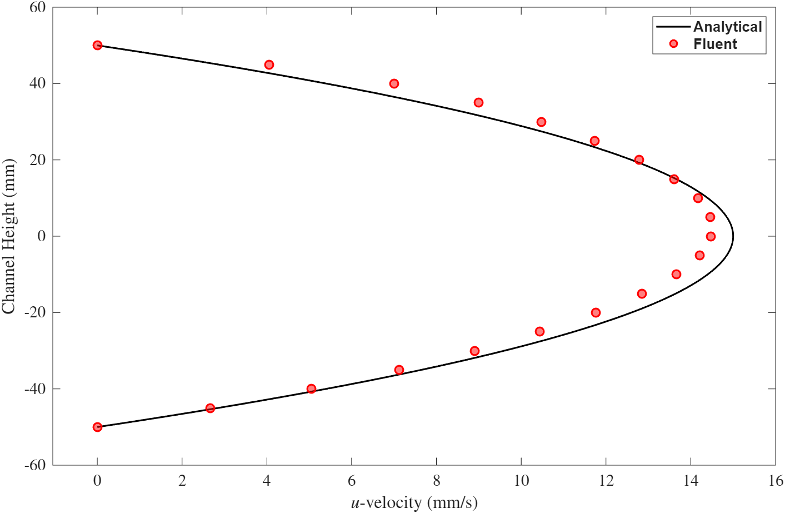
Activity 3 – Temperature-dependent viscosity (results)

